Slide 1
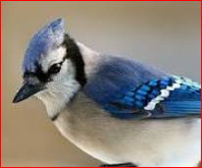
Welcome to UTM Team J Project presentation
Team Members
Wilfred Valencia(Wil)
Joonho Ye
Raghavendra Samaga (Raghu)

Slide 2
Outline of presentation

Slide 3

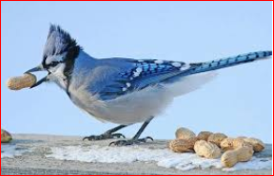
Defining scope
Understand the features in data
World Health Organization
Identify critical features
Focus on at risk
population
Select data source

Slide 4
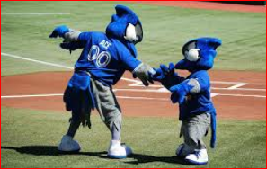
Defining context for usage
1
Prediction of mortality
2
Unknown variations
3
Likelihood
4

Slide 5
Defining target performance

Slide 6
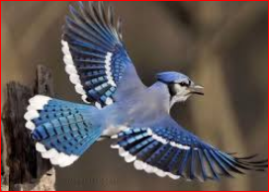
Defining the solution
Machine Learning Workflow
1
Process WHO data sheet
2
Transform data as required
Excel spreadsheets
Jupiter Notebook
numpy–scientific computing
pandas –data frames
matplotlib–2D plotting
scikit-learn
Algorithms
Pre-processing
Performance evaluation
And more …
3

Slide 7
Machine Learning Work flow
Preparing and tidying the data
General trend analysis
Selecting the algorithm to train the model
Testing the Model

Slide 9
Thank you!
Questions?

Slide 10

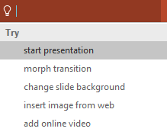

More questions about Project?
Select the Tell Me button and type what you want to know.
Visit the PowerPoint team blog
Go to free PowerPoint training
Give feedback about this tour
SELECT THE ARROW WHEN IN SLIDE SHOW MODE
Notes:
In Slide Show mode, select the arrows to visit links.

